Slide 1
Chapter 06_07 Dynamic Programming The Traveling Salesperson Problem

Slide 2
Dynamic Programming: The Traveling Salesperson Problem
A salesperson is planning a sales trip for n cities.
Each city is connected to some of the other cities by a road.
The problem is to determine the shortest route that
starts at his home city,
visits each of the cities once, and
ends up at the home city.
The problem of determining a shortest route is called the Traveling Salesperson problem.

Slide 3
Dynamic Programming: The Traveling Salesperson Problem (TSP)
An instance of this (TSP) problem can be represented by a weighted graph, in which each vertex represents a city.
Assume that the weights are nonnegative numbers.
A weight represents distance going in one direction between two cities (vertices) and could be different from the weight going in another direction between the same two cities.
Figure 6.7.1. The optimal tour is [v₁, v₃, v₄, v₂, v₁].
2
v₁
v₂
1
3
6
7
6
9
4
v₄
8
v₃

Slide 4
Dynamic Programming: The Traveling Salesperson Problem (TSP)
A tour (also called a Hamiltonian circuit) in a directed graph is a path from a vertex to itself that passes through each of the other vertices exactly once.
An optimal tour in a weighted, directed graph is such a path of minimum length.
The TSP is to find an optimal tour in a weighted, directed graph when at least one tour exists.
Figure 6.7.1. The optimal tour is [v₁, v₃, v₄, v₂, v₁].
2
v₁
v₂
1
3
6
7
6
9
4
v₄
8
v₃

Slide 5
Dynamic Programming: The Traveling Salesperson Problem (TSP)
Consider v₁ to be the starting vertex. There are three tours and lengths from the graph in Figure 6.7.1.
length [v₁, v₂, v₃, v₄, v₁] = 22.
length [v₁, v₃, v₂, v₄, v₁] = 26.
length [v₁, v₃, v₄, v₂, v₁] = 21. This is an optimal tour.
Figure 6.7.1. The optimal tour is [v₁, v₃, v₄, v₂, v₁].
2
v₁
v₂
1
3
6
7
6
9
4
v₄
8
v₃

Slide 6
Dynamic Programming: The Traveling Salesperson Problem (TSP)
We solve this instance by simply considering all possible tours.
In general, there can be an edge from every vertex to every other vertex. When consider all possible tours, the second vertex on the tour can be any n-1 vertices, the third vertex on the tour can be any of n-2 vertices, …, the nth vertex on the tour can be only one vertex. Thus, the total number of tours is (n-1)(n-2)…1 = (n-1)! which is worse than exponential.
Figure 6.7.1. The optimal tour is [v₁, v₃, v₄, v₂, v₁].
2
v₁
v₂
1
3
6
7
6
9
4
v₄
8
v₃

Slide 7
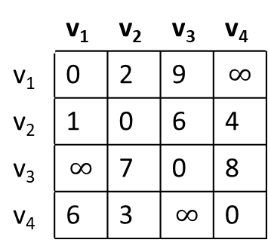
Dynamic Programming: The Traveling Salesperson Problem (TSP)
Can dynamic programming be applied to this problem?
If v_{k} is the first vertex after v₁ on an optimal tour, the subpath of that tour from v_{k} to v₁ must be the shortest path from v_{k} to v₁ that passes through each of the other vertices exactly once. [v₁, v_{k}, …, v₁] is a simple path.
This means that the principle of optimality applies, and we can use dynamic programming.
The adjacency matrix in Figure 6.7.2 represents the weight directed graph in Figure 6.7.1.
Figure 6.7.2. The adjacency matrix Figure 6.7.1. The optimal tour is representation W of the graph in Fig 6.7.1. [v₁, v₃, v₄, v₂, v₁].
2
 | v₁ | v₂ | v₃ | v₄
v₁ | 0 | 2 | 9 | $$∞$$
v₂ | 1 | 0 | 6 | 4
v₃ | $$∞$$ | 7 | 0 | 8
v₄ | 6 | 3 | $$∞$$ | 0
v₁
v₂
1
3
6
7
6
9
4
v₄
8
v₃

Slide 8
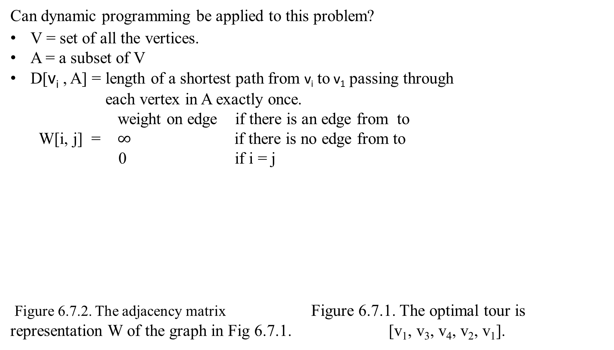
Dynamic Programming: The Traveling Salesperson Problem (TSP)
Can dynamic programming be applied to this problem?
V = set of all the vertices.
A = a subset of V
D[v_{i} , A] = length of a shortest path from v_{i} to v₁ passing through
each vertex in A exactly once.
weight on edge if there is an edge from to
W[i, j] = $∞$ if there is no edge from to
0 if i = j
Figure 6.7.2. The adjacency matrix Figure 6.7.1. The optimal tour is representation W of the graph in Fig 6.7.1. [v₁, v₃, v₄, v₂, v₁].
2
 | v₁ | v₂ | v₃ | v₄
v₁ | 0 | 2 | 9 | $$∞$$
v₂ | 1 | 0 | 6 | 4
v₃ | $$∞$$ | 7 | 0 | 8
v₄ | 6 | 3 | $$∞$$ | 0
v₁
v₂
1
3
6
7
6
9
4
v₄
8
v₃

Slide 9
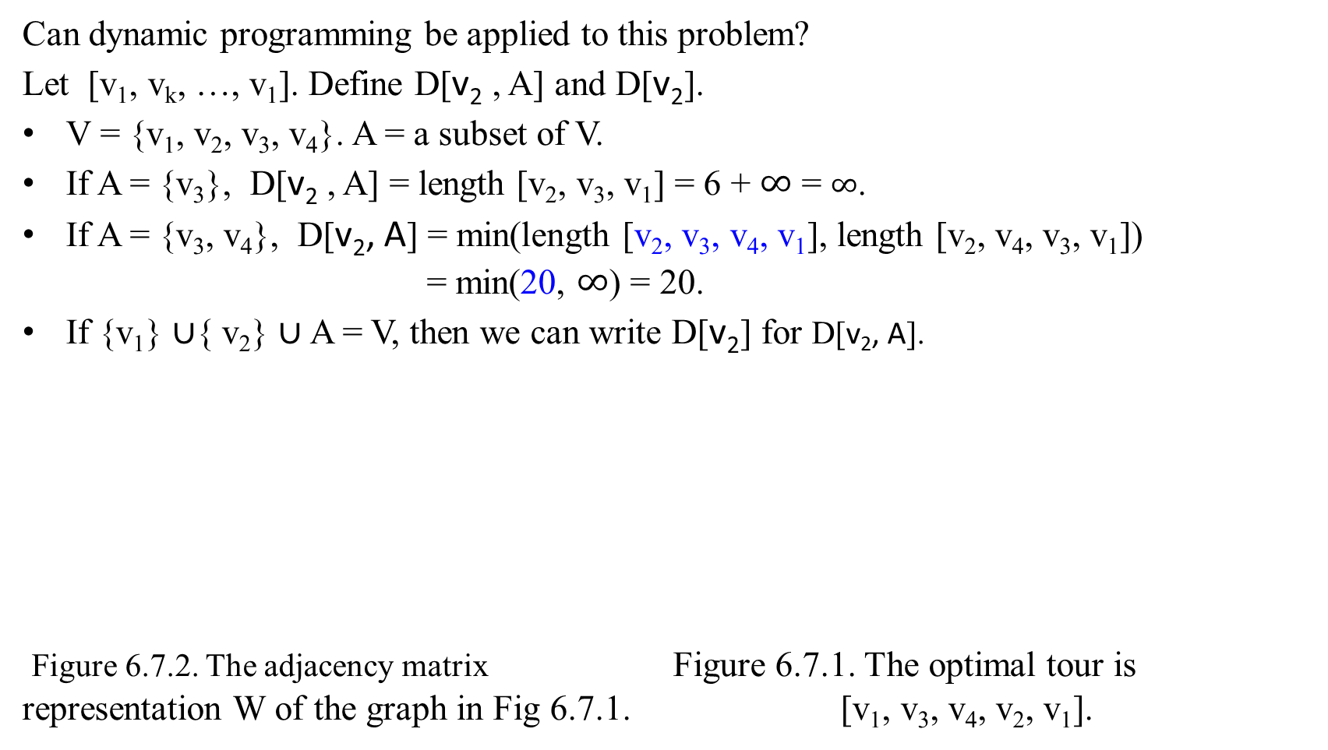
Dynamic Programming: The Traveling Salesperson Problem (TSP)
Can dynamic programming be applied to this problem?
Let [v₁, v_{k}, …, v₁]. Define D[v₂ , A] and D[v₂].
V = {v₁, v₂, v₃, v₄}. A = a subset of V.
If A = {v₃}, D[v₂ , A] = length [v₂, v₃, v₁] = 6 + $∞$ = $∞$.
If A = {v₃, v₄}, D[v₂, A] = min(length [v₂, v₃, v₄, v₁], length [v₂, v₄, v₃, v₁]) = min(20, $∞$) = 20.
If {v₁} $∪${ v₂} $∪$A = V, then we can write D[v₂] for D[v₂, A].
Figure 6.7.2. The adjacency matrix Figure 6.7.1. The optimal tour is representation W of the graph in Fig 6.7.1. [v₁, v₃, v₄, v₂, v₁].
2
 | v₁ | v₂ | v₃ | v₄
v₁ | 0 | 2 | 9 | $$∞$$
v₂ | 1 | 0 | 6 | 4
v₃ | $$∞$$ | 7 | 0 | 8
v₄ | 6 | 3 | $$∞$$ | 0
v₁
v₂
1
3
6
7
6
9
4
v₄
8
v₃

Slide 10
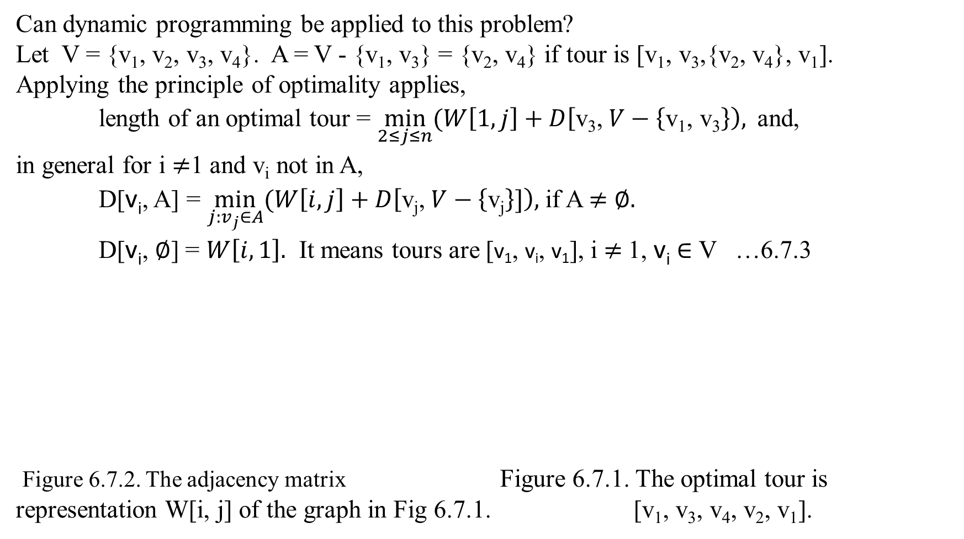
Dynamic Programming: The Traveling Salesperson Problem (TSP)
Can dynamic programming be applied to this problem?
Let V = {v₁, v₂, v₃, v₄}. A = V - {v₁, v₃} = {v₂, v₄} if tour is [v₁, v₃,{v₂, v₄}, v₁].
Applying the principle of optimality applies,
length of an optimal tour = $\min_{2≤j≤n}{(W\left[1, j\right]+D\left[\text{v}\text{3}\text{,} V−\left\{\text{v}\text{1}\text{, }\text{v}\text{3}\right\}\right),}$ and,
in general for i $≠$1 and v_{i} not in A,
D[v_{i}, A] = $\min_{j:v_{j}∈A}{(W\left[i, j\right]+D\left[\text{v}\text{j}\text{,} V−\left\{\text{v}\text{j}\right\}]\right),}$if A $≠$ $∅.$
D[v_{i}, $∅$] = $W\left[i, 1\right].$ It means tours are [v₁, v_{i}, v₁], i $≠$1, v_{i} $∈$ V …6.7.3
Figure 6.7.2. The adjacency matrix Figure 6.7.1. The optimal tour is representation W[i, j] of the graph in Fig 6.7.1. [v₁, v₃, v₄, v₂, v₁].
2
 | v₁ | v₂ | v₃ | v₄
v₁ | 0 | 2 | 9 | $$∞$$
v₂ | 1 | 0 | 6 | 4
v₃ | $$∞$$ | 7 | 0 | 8
v₄ | 6 | 3 | $$∞$$ | 0
v₁
v₂
1
3
6
7
6
9
4
v₄
8
v₃

Slide 11
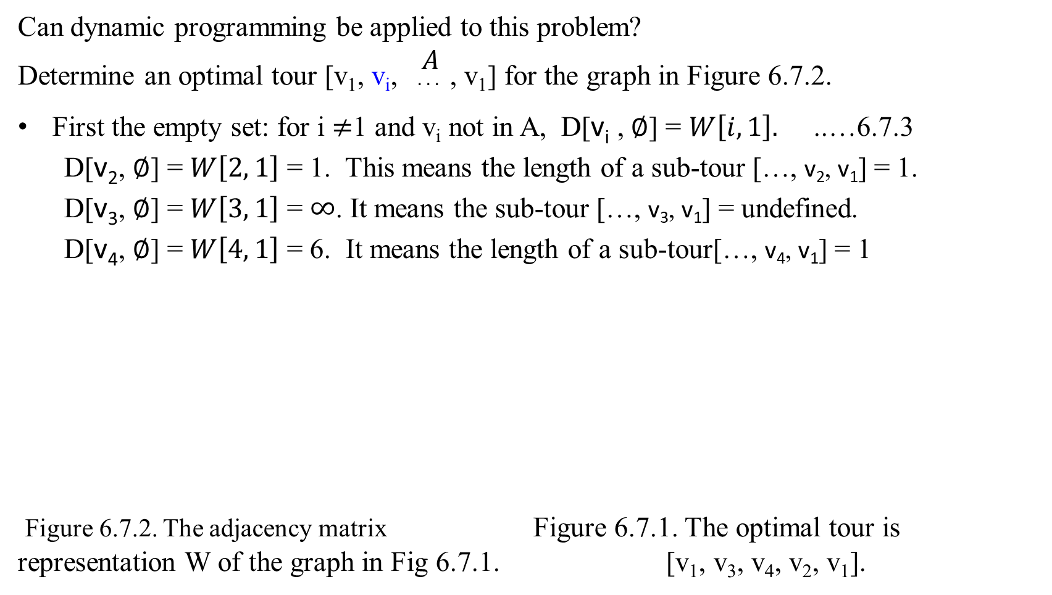
Dynamic Programming: The Traveling Salesperson Problem (TSP)
Can dynamic programming be applied to this problem?
Determine an optimal tour [v₁, v_{i}, $\begin{matrix}A \\ . . . \end{matrix}$ , v₁] for the graph in Figure 6.7.2.
First the empty set: for i $≠$1 and v_{i} not in A, D[v_{i} , $∅$] = $W\left[i, 1\right].$ ..…6.7.3
D[v₂, $∅$] = $W\left[2, 1\right]$ = 1. This means the length of a sub-tour […, v₂, v₁] = 1.
D[v₃, $∅$] = $W\left[3, 1\right]$ = $∞$. It means the sub-tour […, v₃, v₁] = undefined.
D[v₄, $∅$] = $W\left[4, 1\right]$ = 6. It means the length of a sub-tour[…, v₄, v₁] = 1
Figure 6.7.2. The adjacency matrix Figure 6.7.1. The optimal tour is representation W of the graph in Fig 6.7.1. [v₁, v₃, v₄, v₂, v₁].
2
 | v₁ | v₂ | v₃ | v₄
v₁ | 0 | 2 | 9 | $$∞$$
v₂ | 1 | 0 | 6 | 4
v₃ | $$∞$$ | 7 | 0 | 8
v₄ | 6 | 3 | $$∞$$ | 0
v₁
v₂
1
3
6
7
6
9
4
v₄
8
v₃

Slide 12
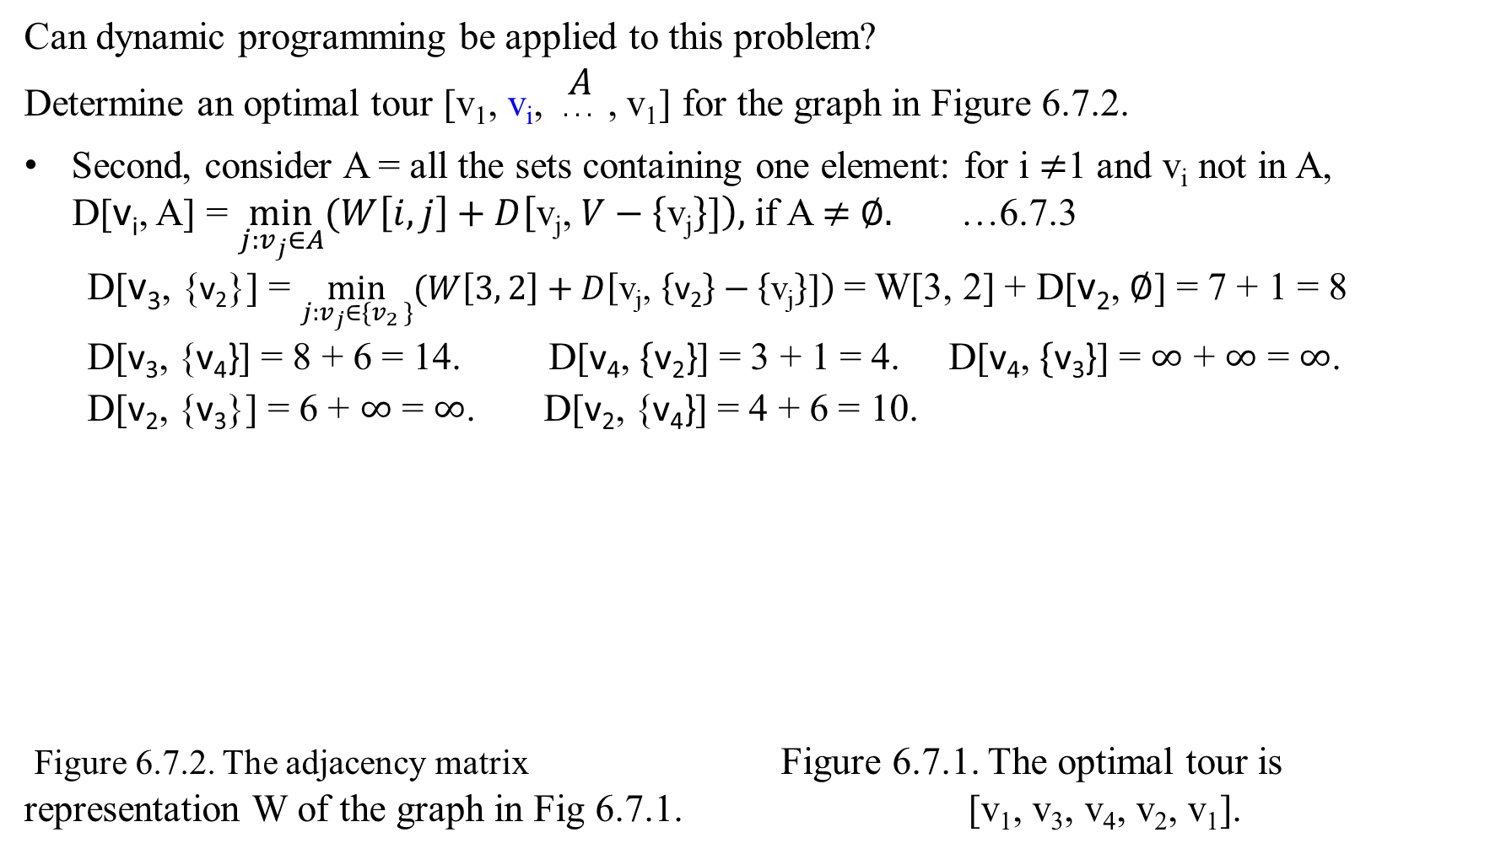
Dynamic Programming: The Traveling Salesperson Problem (TSP)
Can dynamic programming be applied to this problem?
Determine an optimal tour [v₁, v_{i}, $\begin{matrix}A \\ . . . \end{matrix}$ , v₁] for the graph in Figure 6.7.2.
Second, consider A = all the sets containing one element: for i $≠$1 and v_{i} not in A,
D[v_{i}, A] = $\min_{j:v_{j}∈A}{(W\left[i, j\right]+D\left[\text{v}\text{j}\text{,} V−\left\{\text{v}\text{j}\right\}]\right),}$if A $≠$ $∅.$ …6.7.3
D[v₃, {$\text{v}\text{2}$}] = $\min_{j:v_{j}∈{\{v}_{2 }\}}{(W\left[3, 2\right]+D\left[\text{v}\text{j}\text{,} \left\{\text{v}\text{2}\right\}−\left\{\text{v}\text{j}\right\}]\right) }$= W[3, 2] + D[$\text{v}\text{2}$, $∅$] = 7 + 1 = 8
D[v₃, {$\text{v}\text{4}\text{\}}$] = 8 + 6 = 14. D[v₄, $\{\text{v}\text{2}\text{\}}$] = 3 + 1 = 4. D[v₄, $\{\text{v}\text{3}\text{\}}$] = $∞$ + $∞$ = $∞$.
D[v₂, {$\text{v}\text{3}$}] = 6 + $∞$ = $∞$. D[v₂, {$\text{v}\text{4}\text{\}}$] = 4 + 6 = 10.
Figure 6.7.2. The adjacency matrix Figure 6.7.1. The optimal tour is representation W of the graph in Fig 6.7.1. [v₁, v₃, v₄, v₂, v₁].
2
 | v₁ | v₂ | v₃ | v₄
v₁ | 0 | 2 | 9 | $$∞$$
v₂ | 1 | 0 | 6 | 4
v₃ | $$∞$$ | 7 | 0 | 8
v₄ | 6 | 3 | $$∞$$ | 0
v₁
v₂
1
3
6
7
6
9
4
v₄
8
v₃

Slide 13
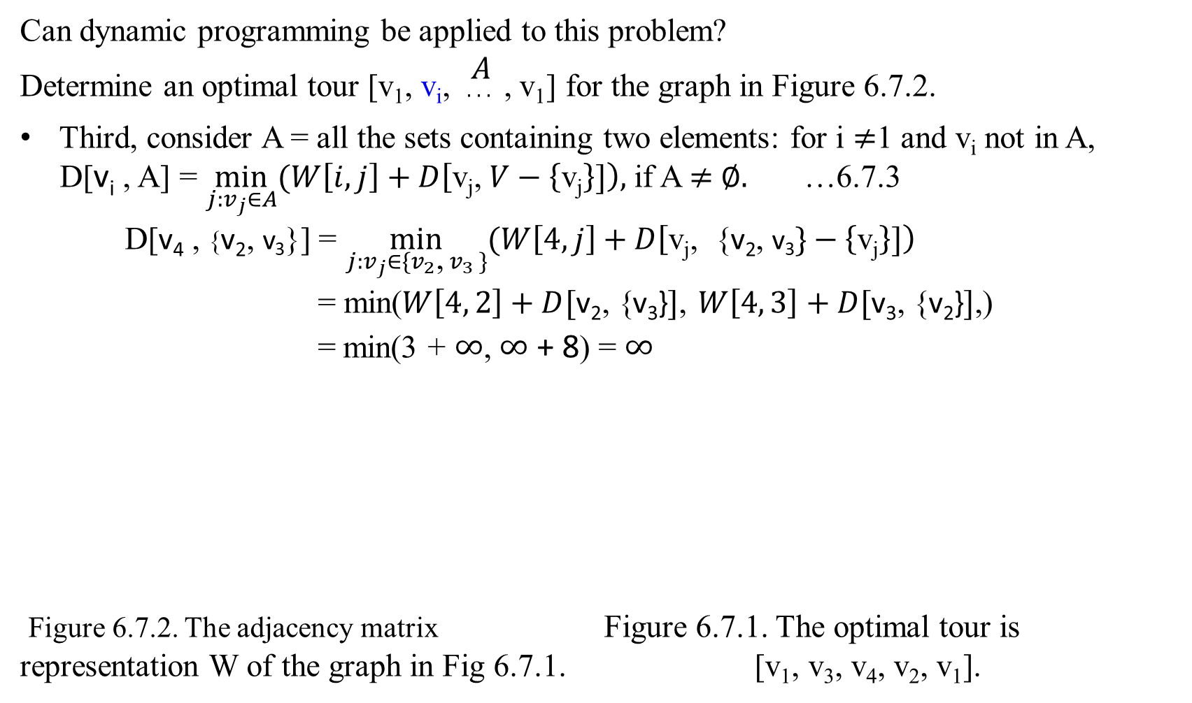
Dynamic Programming: The Traveling Salesperson Problem (TSP)
Can dynamic programming be applied to this problem?
Determine an optimal tour [v₁, v_{i}, $\begin{matrix}A \\ . . . \end{matrix}$ , v₁] for the graph in Figure 6.7.2.
Third, consider A = all the sets containing two elements: for i $≠$1 and v_{i} not in A,
D[v_{i} , A] = $\min_{j:v_{j}∈A}{(W\left[i, j\right]+D\left[\text{v}\text{j}\text{,} V−\left\{\text{v}\text{j}\right\}]\right),}$if A $≠$ $∅.$ …6.7.3
D[v₄ , {$\text{v}\text{2}\text{, }\text{v}\text{3}$}] = $\min_{j:v_{j}∈{\{v}_{2}\text{,}{ v}_{3 }\}}{(W\left[4, j\right]+D\left[\text{v}\text{j}\text{,}\text{ \{}\text{v}\text{2}\text{, }\text{v}\text{3}\}−\left\{\text{v}\text{j}\right\}]\right) }$
= min($W\left[4, 2\right]+D[\text{v}\text{2}\text{,}\text{ \{}\text{v}\text{3}\text{\}}]$, $W\left[4, 3\right]+D[\text{v}\text{3}\text{, \{}\text{v}\text{2}\text{\}}]\text{,}$)
= min(3 + $∞$, $∞$ + 8) = $∞$
Figure 6.7.2. The adjacency matrix Figure 6.7.1. The optimal tour is representation W of the graph in Fig 6.7.1. [v₁, v₃, v₄, v₂, v₁].
2
 | v₁ | v₂ | v₃ | v₄
v₁ | 0 | 2 | 9 | $$∞$$
v₂ | 1 | 0 | 6 | 4
v₃ | $$∞$$ | 7 | 0 | 8
v₄ | 6 | 3 | $$∞$$ | 0
v₁
v₂
1
3
6
7
6
9
4
v₄
8
v₃

Slide 14

Dynamic Programming: The Traveling Salesperson Problem (TSP)
Can dynamic programming be applied to this problem?
Determine an optimal tour [v₁, v_{i}, $\begin{matrix}A \\ . . . \end{matrix}$ , v₁] for the graph in Figure 6.7.2.
Third, consider A = all the sets containing two elements: for i $≠$1 and v_{i} not in A,
D[v_{i} , A] = $\min_{j:v_{j}∈A}{(W\left[i, j\right]+D\left[\text{v}\text{j}\text{,} V−\left\{\text{v}\text{j}\right\}]\right),}$if A $≠$ $∅.$ …6.7.3
D[v₃ , {$\text{v}\text{2}\text{, }\text{v}\text{4}$}] = $\min_{j:v_{j}∈{\{v}_{2}\text{,}{ v}_{4 }\}}{(W\left[3, j\right]+D\left[\text{v}\text{j}\text{, \{}\text{v}\text{2}\text{, }\text{v}\text{4}\}−\left\{\text{v}\text{j}\right\}]\right) }$
= min($W\left[3, 2\right]+D[\text{v}\text{2}\text{, \{}\text{v}\text{4}\text{\}}]$, $W\left[3, 4\right]+D[\text{v}\text{4}\text{, \{}\text{v}\text{2}\text{\}}]\text{,}$)
= min(7 + 10, 8 + 4) = 12
Figure 6.7.2. The adjacency matrix Figure 6.7.1. The optimal tour is representation W of the graph in Fig 6.7.1. [v₁, v₃, v₄, v₂, v₁].
2
 | v₁ | v₂ | v₃ | v₄
v₁ | 0 | 2 | 9 | $$∞$$
v₂ | 1 | 0 | 6 | 4
v₃ | $$∞$$ | 7 | 0 | 8
v₄ | 6 | 3 | $$∞$$ | 0
v₁
v₂
1
3
6
7
6
9
4
v₄
8
v₃

Slide 15

Dynamic Programming: The Traveling Salesperson Problem (TSP)
Can dynamic programming be applied to this problem?
Determine an optimal tour [v₁, v_{i}, $\begin{matrix}A \\ . . . \end{matrix}$ , v₁] for the graph in Figure 6.7.2.
Third, consider A = all the sets containing two elements: for i $≠$1 and v_{i} not in A,
D[v_{i} , A] = $\min_{j:v_{j}∈A}{(W\left[i, j\right]+D\left[\text{v}\text{j}\text{,} V−\left\{\text{v}\text{j}\right\}]\right),}$if A $≠$ $∅.$ …6.7.3
D[v₂ , {$\text{v}\text{3}\text{, }\text{v}\text{4}$}] = $\min_{j:v_{j}∈{\{v}_{3}\text{,}{ v}_{4 }\}}{(W\left[2, j\right]+D\left[\text{v}\text{j}\text{, \{}\text{v}\text{3}\text{, }\text{v}\text{4}\}−\left\{\text{v}\text{j}\right\}]\right) }$
= min($W\left[2, 3\right]+D[\text{v}\text{3}\text{, \{}\text{v}\text{4}\text{\}}]$, $W\left[2, 4\right]+D[\text{v}\text{4}\text{, \{}\text{v}\text{3}\text{\}}]\text{,}$)
= min(6 + 14, 4 + $∞$) = 20
Figure 6.7.2. The adjacency matrix Figure 6.7.1. The optimal tour is representation W of the graph in Fig 6.7.1. [v₁, v₃, v₄, v₂, v₁].
2
 | v₁ | v₂ | v₃ | v₄
v₁ | 0 | 2 | 9 | $$∞$$
v₂ | 1 | 0 | 6 | 4
v₃ | $$∞$$ | 7 | 0 | 8
v₄ | 6 | 3 | $$∞$$ | 0
v₁
v₂
1
3
6
7
6
9
4
v₄
8
v₃

Slide 16
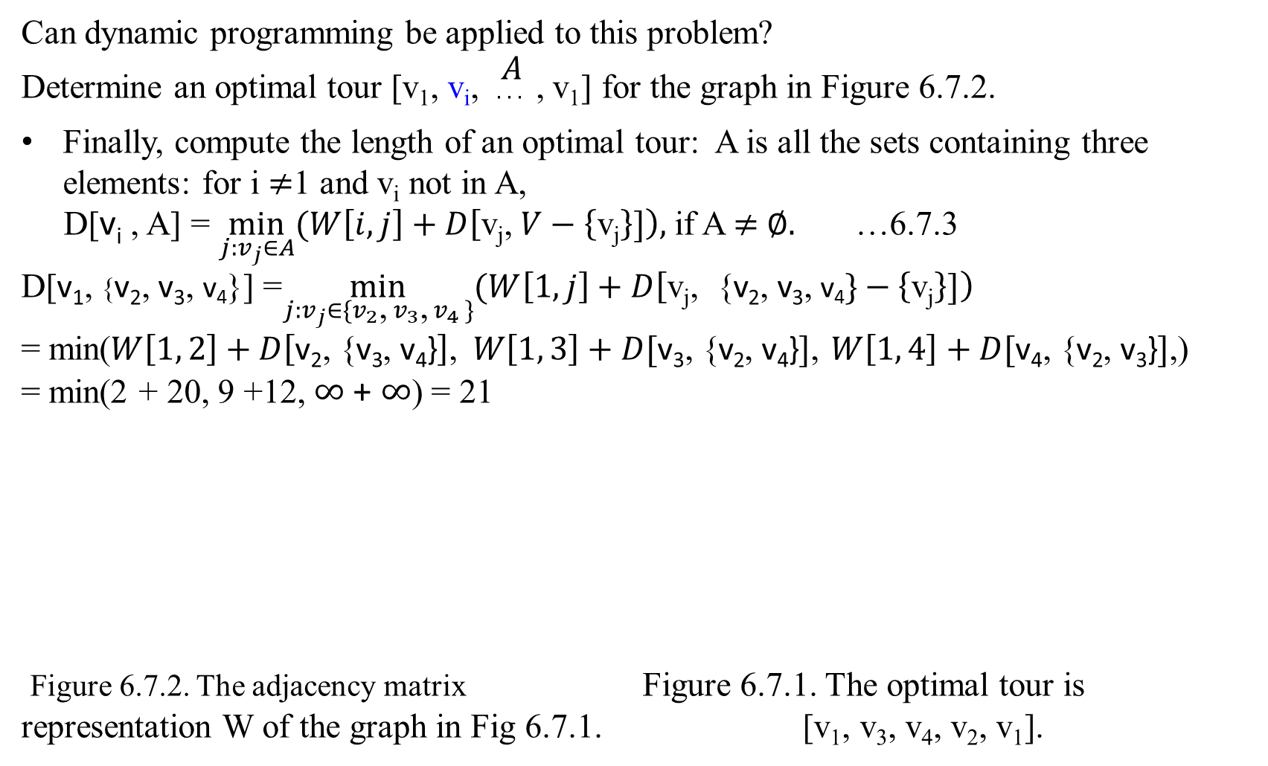
Dynamic Programming: The Traveling Salesperson Problem (TSP)
Can dynamic programming be applied to this problem?
Determine an optimal tour [v₁, v_{i}, $\begin{matrix}A \\ . . . \end{matrix}$ , v₁] for the graph in Figure 6.7.2.
Finally, compute the length of an optimal tour: A is all the sets containing three elements: for i $≠$1 and v_{i} not in A,
D[v_{i} , A] = $\min_{j:v_{j}∈A}{(W\left[i, j\right]+D\left[\text{v}\text{j}\text{,} V−\left\{\text{v}\text{j}\right\}]\right),}$if A $≠$ $∅.$ …6.7.3
D[v₁, {v₂, $\text{v}\text{3}\text{, }\text{v}\text{4}$}] =$\min_{j:v_{j}∈{\{v}_{2}\text{,}{{ v}_{3}\text{,} v}_{4 }\}}{(W\left[1, j\right]+D\left[\text{v}\text{j}\text{, \{}\text{v}\text{2}\text{,} \text{v}\text{3}\text{,} \text{v}\text{4}\}−\left\{\text{v}\text{j}\right\}]\right) }$
= min($W\left[1, 2\right]+D\left[\text{v}\text{2}\text{, \{}\text{v}\text{3}\text{,} \text{v}\text{4}\text{\}}\right]\text{,} W\left[1, 3\right]+D[\text{v}\text{3}\text{, \{}\text{v}\text{2}\text{,} \text{v}\text{4}\text{\}}]$, $W\left[1, 4\right]+D[\text{v}\text{4}\text{, \{}\text{v}\text{2}\text{,} \text{v}\text{3}\text{\}}]\text{,}$)
= min(2 + 20, 9 +12, $∞$ + $∞$) = 21
Figure 6.7.2. The adjacency matrix Figure 6.7.1. The optimal tour is representation W of the graph in Fig 6.7.1. [v₁, v₃, v₄, v₂, v₁].
2
 | v₁ | v₂ | v₃ | v₄
v₁ | 0 | 2 | 9 | $$∞$$
v₂ | 1 | 0 | 6 | 4
v₃ | $$∞$$ | 7 | 0 | 8
v₄ | 6 | 3 | $$∞$$ | 0
v₁
v₂
1
3
6
7
6
9
4
v₄
8
v₃

Slide 17
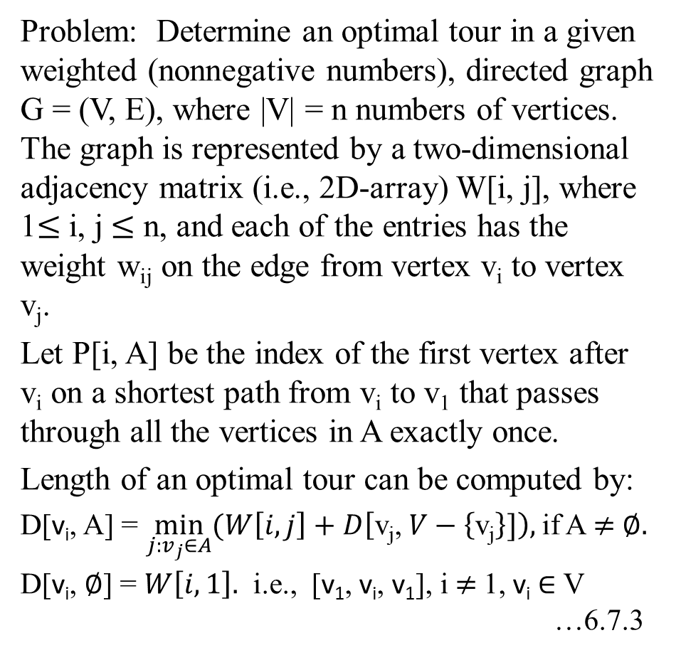
The Dynamic Programming Algorithm for The Traveling Salesperson Problem
Problem: Determine an optimal tour in a given weighted (nonnegative numbers), directed graph G = (V, E), where |V| = n numbers of vertices. The graph is represented by a two-dimensional adjacency matrix (i.e., 2D-array) W[i, j], where 1$≤$ i, j $≤$ n, and each of the entries has the weight w_{ij} on the edge from vertex v_{i} to vertex v_{j}.
Let P[i, A] be the index of the first vertex after v_{i} on a shortest path from v_{i} to v₁ that passes through all the vertices in A exactly once.
Length of an optimal tour can be computed by:
D[v_{i}, A] = $\min_{j:v_{j}∈A}{(W\left[i, j\right]+D\left[\text{v}\text{j}\text{,} V−\left\{\text{v}\text{j}\right\}]\right),}$if A $≠$ $∅.$
D[v_{i}, $∅$] = $W\left[i, 1\right].$ i.e., [v₁, v_{i}, v₁], i $≠$1, v_{i} $∈$ V …6.7.3
 | v₁ | v₂ | v₃ | … | v_{j} | … | v_{n}
v₁ | w₁₁ | w₁₂ | w₁₃ |  | w_{1j} |  | w_{1n}
v₂ | w₂₁ |  |  |  |  |  | w_{2n}
v₃ | w₃₁ |  |  |  |  |  | w_{3n}
…
v_{i} | w_{i1} |  |  |  | w_{ij} |  | w_{in}
…
v_{n} | w_{n1} | w_{n2} |  |  |  |  | w_{nn}
Figure 6.7.4 An adjacency matrix W[1..n, 1..n].

Slide 18
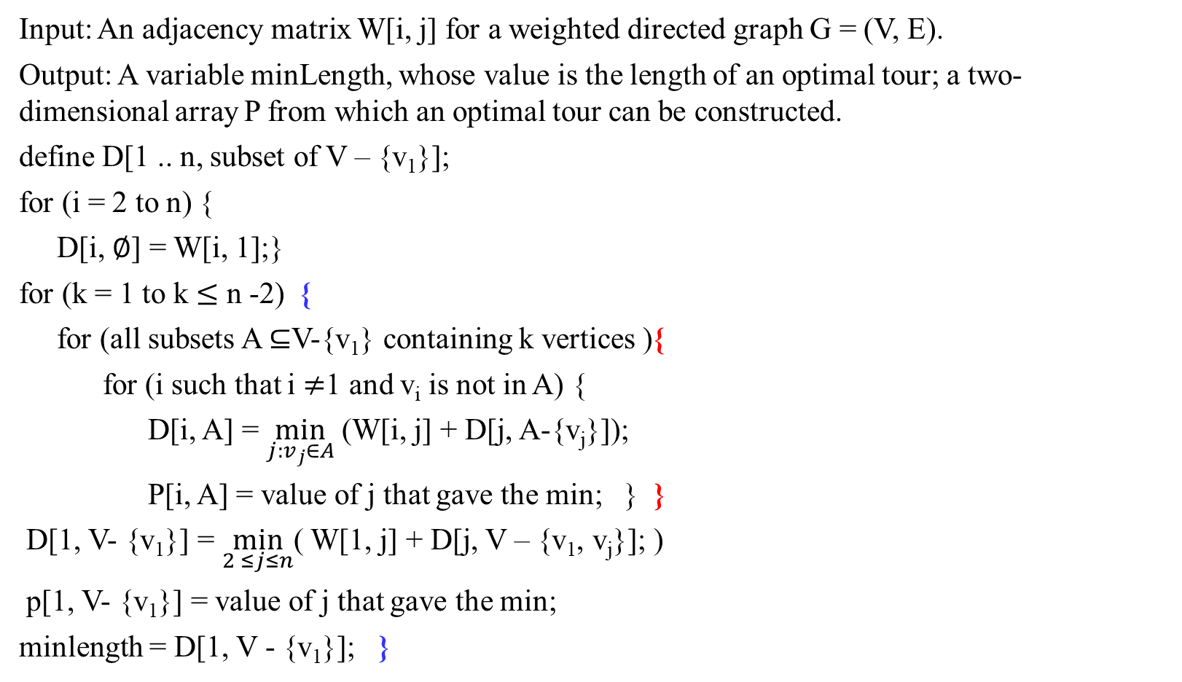
The Dynamic Programming Algorithm for The Traveling Salesperson Problem
Input: An adjacency matrix W[i, j] for a weighted directed graph G = (V, E).
Output: A variable minLength, whose value is the length of an optimal tour; a two-dimensional array P from which an optimal tour can be constructed.
define D[1 .. n, subset of V – {v₁}];
for (i = 2 to n) {
D[i, $∅$] = W[i, 1];}
for (k = 1 to k $≤$ n -2) {
for (all subsets A ⊆V-{v₁} containing k vertices ){
for (i such that i $≠$1 and v_{i} is not in A) {
D[i, A] = $\min_{j:v_{j}∈A}$ (W[i, j] + D[j, A-{v_{j}}]);
P[i, A] = value of j that gave the min; } }
D[1, V- {v₁}] = $\min_{2 ≤j≤n}$( W[1, j] + D[j, V – {v₁, v_{j}}]; )
p[1, V- {v₁}] = value of j that gave the min;
minlength = D[1, V - {v₁}]; }

Slide 19
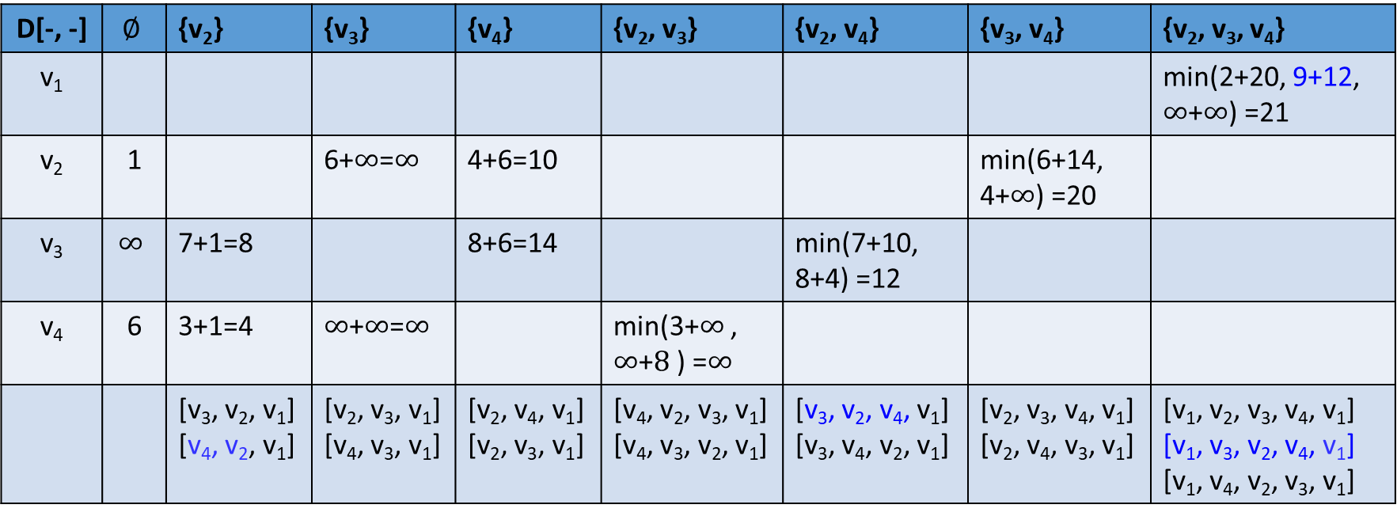
Define D[1 .. n, subset of V – {v₁}].
D[-, -] | $$∅$$ | {v₂} | {v₃} | {v₄} | {v₂, v₃} | {v₂, v₄} | {v₃, v₄} | {v₂, v₃, v₄}
v₁ |  |  |  |  |  |  |  | min(2+20, 9+12, $∞$+$∞$) =21
v₂ | 1 |  | 6+$∞$=$∞$ | 4+6=10 |  |  | min(6+14, 4+$∞$) =20
v₃ | $$∞$$ | 7+1=8 |  | 8+6=14 |  | min(7+10, 8+4) =12
v₄ | 6 | 3+1=4 | $∞$+$∞$=$∞$ |  | min(3+$∞$ , $∞$+$8$ ) =$∞$
 |  | [v₃, v₂, v₁] [v₄, v₂, v₁] | [v₂, v₃, v₁] [v₄, v₃, v₁] | [v₂, v₄, v₁] [v₂, v₃, v₁] | [v₄, v₂, v₃, v₁] [v₄, v₃, v₂, v₁] | [v₃, v₂, v₄, v₁] [v₃, v₄, v₂, v₁] | [v₂, v₃, v₄, v₁] [v₂, v₄, v₃, v₁] | [v₁, v₂, v₃, v₄, v₁] [v₁, v₃, v₂, v₄, v₁] [v₁, v₄, v₂, v₃, v₁]

Slide 20

The Dynamic Programming Algorithm for The Traveling Salesperson Problem
Background:
k($\begin{matrix}n \\ k\end{matrix}$) = n($\begin{matrix}n−1 \\ k−1\end{matrix}$).
$\sum_{k=1}^{n}{\text{k}\text{(}\begin{matrix}n \\ k\end{matrix}\text{)}}$ = $\sum_{k=1}^{n}{\text{n}\text{(}\begin{matrix}n−1 \\ k−1\end{matrix}\text{) }}$
= n$\sum_{k=1}^{n}{\text{(}\begin{matrix}n−1 \\ k\end{matrix}\text{) }}$
= n$2^{n−1}$.

Slide 21
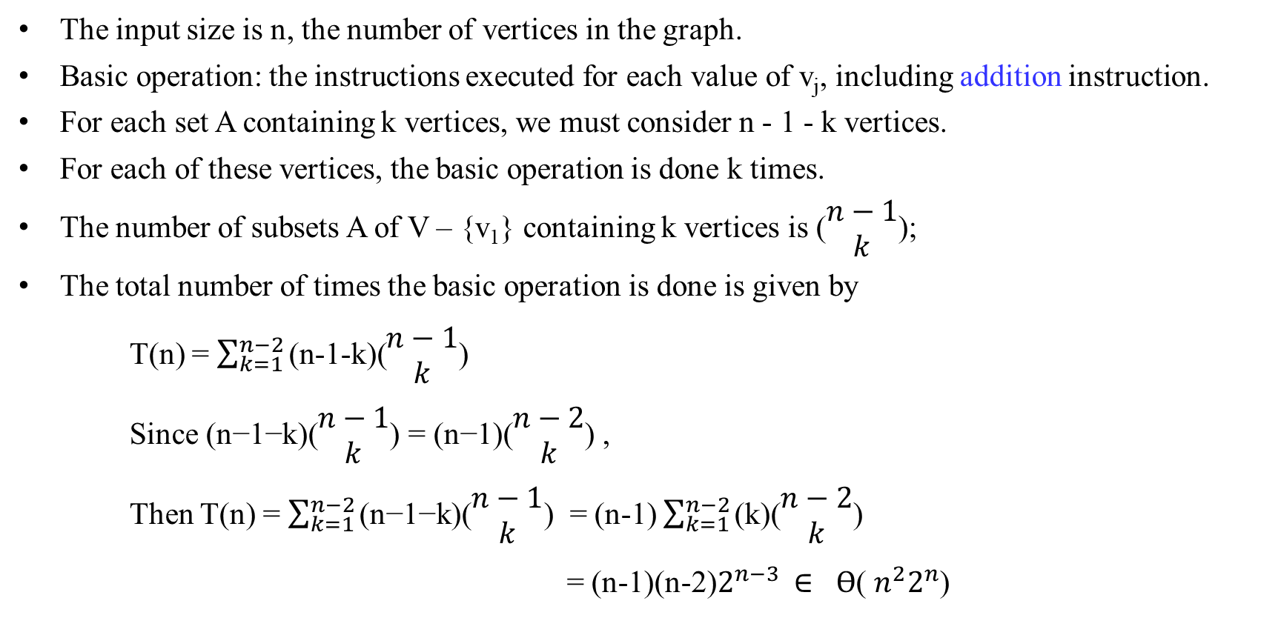
The Dynamic Programming Algorithm for The Traveling Salesperson Problem-Time and space complexity
The input size is n, the number of vertices in the graph.
Basic operation: the instructions executed for each value of v_{j}, including addition instruction.
For each set A containing k vertices, we must consider n - 1 - k vertices.
For each of these vertices, the basic operation is done k times.
The number of subsets A of V – {v₁} containing k vertices is $\text{(}\begin{matrix}n−1 \\ k\end{matrix}\text{)}\text{; }$
The total number of times the basic operation is done is given by
T(n) = $\sum_{k=1}^{n−2}{\text{(}\text{n}\text{−1−}\text{k}\text{)(}\begin{matrix}n−1 \\ k\end{matrix}\text{) }}$
Since $\text{(}\text{n}\text{−1−}\text{k}\text{)(}\begin{matrix}n−1 \\ k\end{matrix}\text{) }$= $\text{(}\text{n}\text{−1)(}\begin{matrix}n−2 \\ k\end{matrix}\text{) }$,
Then T(n) = $\sum_{k=1}^{n−2}{\text{(}\text{n}\text{−1−}\text{k}\text{)(}\begin{matrix}n−1 \\ k\end{matrix}\text{) }}$ = (n-1) $\sum_{k=1}^{n−2}{\text{(}\text{k}\text{)(}\begin{matrix}n−2 \\ k\end{matrix}\text{) }}$
= (n-1)(n-2)$2^{n−3}$ $∈$ $ϴ$( $n^{2}2^{n}$)

Slide 22
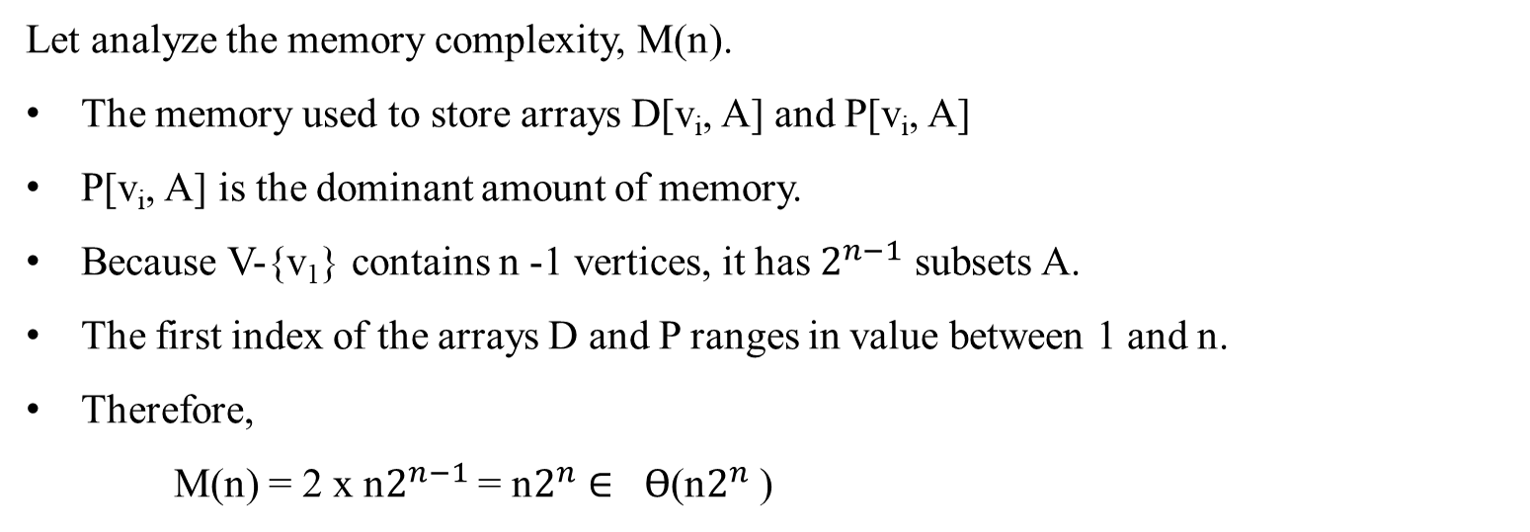
The Dynamic Programming Algorithm for The Traveling Salesperson Problem-Time and space complexity
Let analyze the memory complexity, M(n).
The memory used to store arrays D[v_{i}, A] and P[v_{i}, A]
P[v_{i}, A] is the dominant amount of memory.
Because V-{v₁} contains n -1 vertices, it has $2^{n−1}$ subsets A.
The first index of the arrays D and P ranges in value between 1 and n.
Therefore,
M(n) = 2 x n$2^{n−1}$ = n$2^{n}$ $∈$ $ϴ$(n$2^{n}$ )

Slide 23
The Dynamic Programming Algorithm for The Traveling Salesperson Problem-Time and space complexity
No one has every found an algorithm for the Traveling Salesperson problem whose worse-case time complexity is better than exponential.
No one has ever proved that such an algorithm is not possible.
This problem is one of a large class of closely related problem that share this property.
Examples:
Travelling Salesperson Optimalization Problem,
0-1 Knapsack Optimalization Problem,
Graph-Coloring Optimalization Problem (no two adjacent vertices are colored the same color. The number of color needed is called the chromatic number of the graph),
The Clique Optimization Problem (a maximum clique in an undirected graph is a subgraph of the given undirected graph such that each of the vertices in the subgraph is adjacent to all the other vertices in the subgraph).

Slide 24
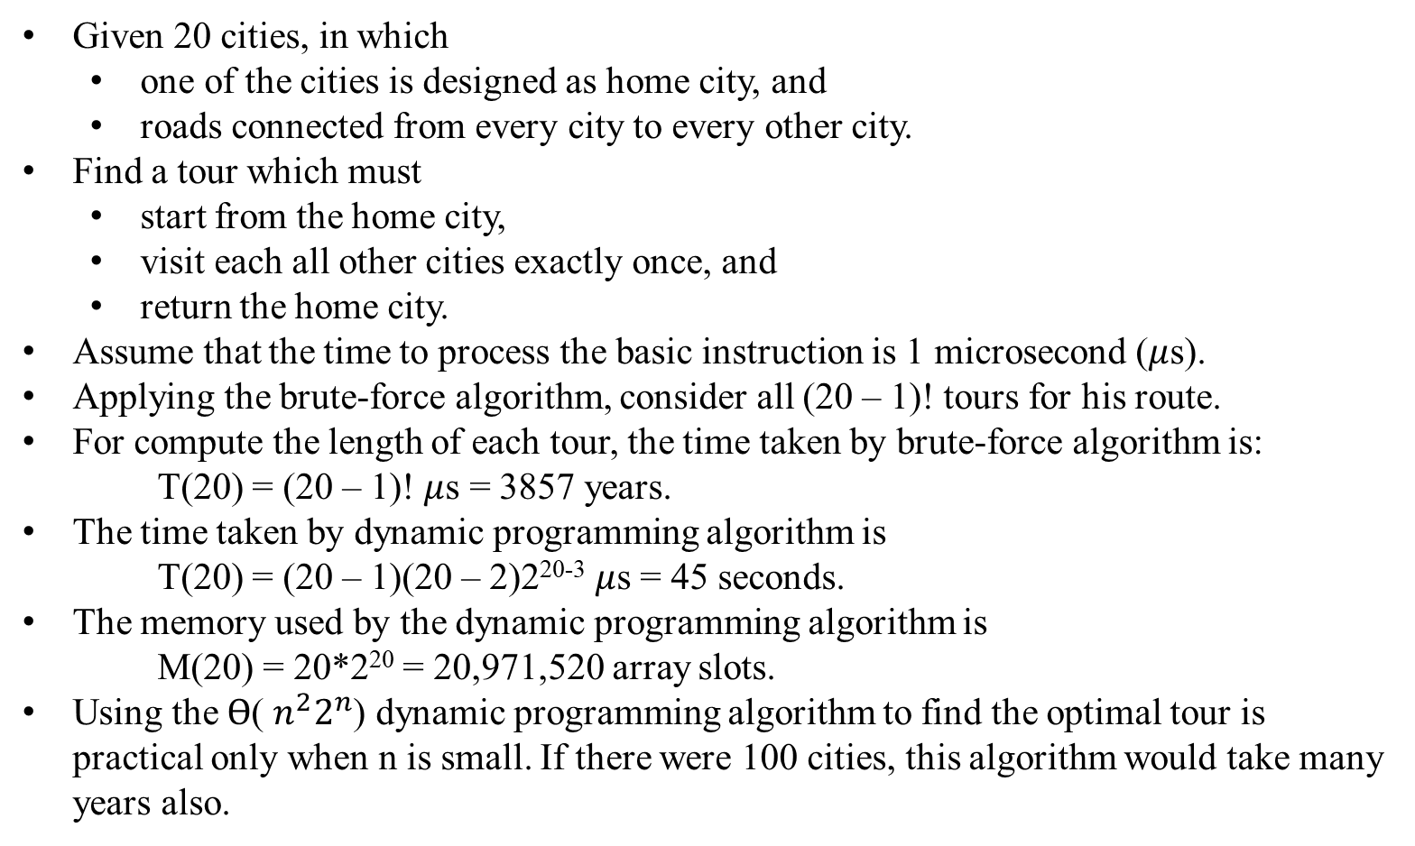
The Dynamic Programming Algorithm for The Traveling Salesperson Problem
Given 20 cities, in which
one of the cities is designed as home city, and
roads connected from every city to every other city.
Find a tour which must
start from the home city,
visit each all other cities exactly once, and
return the home city.
Assume that the time to process the basic instruction is 1 microsecond ($μ$s).
Applying the brute-force algorithm, consider all (20 – 1)! tours for his route.
For compute the length of each tour, the time taken by brute-force algorithm is: T(20) = (20 – 1)! $μ$s = 3857 years.
The time taken by dynamic programming algorithm is T(20) = (20 – 1)(20 – 2)2²⁰⁻³ $μ$s = 45 seconds.
The memory used by the dynamic programming algorithm is M(20) = 20*2²⁰ = 20,971,520 array slots.
Using the $ϴ$( $n^{2}2^{n}$) dynamic programming algorithm to find the optimal tour is practical only when n is small. If there were 100 cities, this algorithm would take many years also.

Slide 25
The Dynamic Programming Algorithm for The Traveling Salesperson Problem
Consider how to retrieve an optimal tour from the array P[i, A].
The members of the array P needed to determine an optimal tour for the graph in Figure 6.7.1 are:
P[1, {v₂, v₃, v₄}] P[3, {v₂, v₄}] P[4, {v₂}]
An optimal tour is as follows:
Index of first node = P[1, {v₂, v₃, v₄}] = 3
Index of second node = P[3, {v₂, v₄}] = 4
Index of third node = P[4, {v₂}] = 2
Thus, the optimal tour is [v₁, v₃, v₄, v₂, v₁].
3
4
2
2
v₁
v₂
1
3
6
7
6
9
4
v₄
8
v₃
Figure 6.7.1. The optimal tour is [v₁, v₃, v₄, v₂, v₁].

Slide 26
End of Ch 06_07 Dynamic Programming_Traveling Salesperson Problem.

